Slide 1
Input and Output in Python
DVT101 – Lecture 3
- By Dataverse Tutorials

Slide 2
Introduction to Input and Output
Input and Output are core concepts
input() is used to take user input
print() is used to display output
Enables user interaction in programs

Slide 3

Taking Input in Python
input() takes user input
Always returns string
Stores value in variable

Slide 4

Printing Output using print()
Displays text and values
Can print strings
Simple and flexible

Slide 5
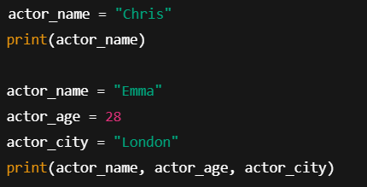
Printing Variables
Print single variable
Print multiple variables
Comma-separated output

Slide 6

Taking Multiple Inputs using split()
Multiple values in one line
split() separates input
Values stored as strings

Slide 7

Typecasting Input in Python
input() returns string
Convert to int or float
Required for calculations

Slide 8
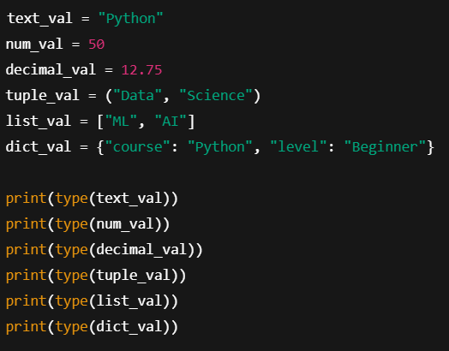
Finding Data Type in Python
type() function
Identifies data type
Useful for debugging

Slide 9
Summary & CTA
input() for user data
print() for output
Typecasting is important
split() for multiple inputs
type() checks data type

Slide 10


